Slide 1

Data Type and Quantization
Cong (Callie) Hao
callie.hao@ece.gatech.edu
Assistant Professor
ECE, Georgia Institute of Technology
Sharc-lab @ Georgia Tech https://sharclab.ece.gatech.edu/

Slide 2


Hardware Design with HLS
Where does performance gain come from?
Specialization
Parallelization
Data-type
Arbitrary fixed-point precision, customized floating-point precision
Memory and data movement
Customized data storage in banks
Customized data loading and feeding
Computation
How do you schedule the computations?
Order, granularity, etc.
Operation level parallelism
Multiple operations or instructions executed simultaneously
Mostly about loop manipulation and data partitioning
Task level parallelism (TLP)
Dataflow and streaming
Overlapped compute and data movement

Slide 3
Why Datatype Matters
Data Type = Architecture Decision
Data type determines:
DSP usage
BRAM / URAM capacity
Memory bandwidth
Pipeline depth & II
On FPGA:
Saving 1 bit can save DSPs, buffers, and routing
Many 10×–100× speedups come from:
Data-type specialization, not algorithm changes

Slide 4
Outline
Floating-point and fixed-point representations
Data quantization in Machine Learning

Slide 5
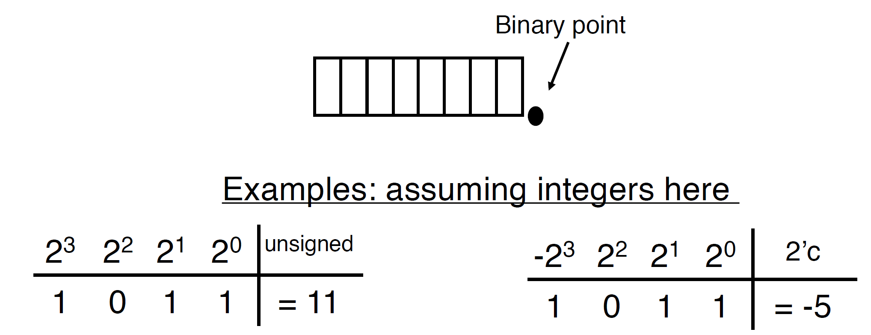
Binary Number Representation
Unsigned number
MSB has weight 2^{n-1}
Signed number
MSB has weight -2^{n-1}
decimal point

Slide 6
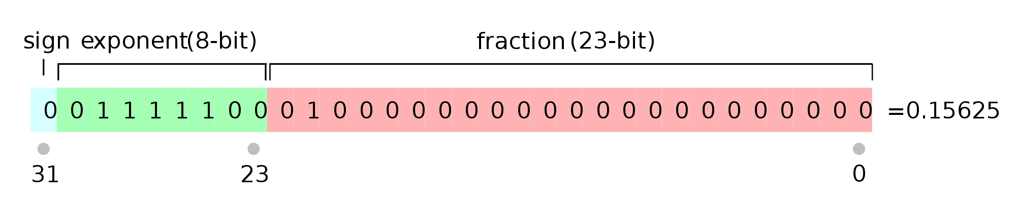
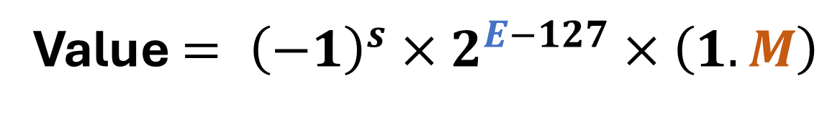
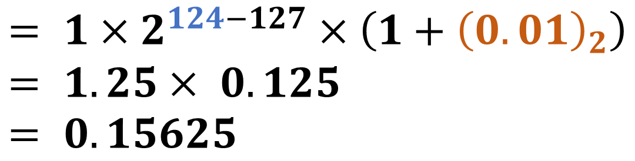
IEEE 754 Floating Point Standard
Exponent (8-bit)
Mantissa (23-bit)
decimal point
Value $= {\left(−1\right)}^{s}×2^{E−127}×\left(1.M\right)$
$$= 1×2^{124−127}×\left(1+{\left(0.01\right)}_{2}\right) \\ = 1.25× 0.125 \\ = 0.15625$$

Slide 7
Using Existing Data Types in Hardware
C/C++ only provides a limited set of native integer types
Integers: char (8b), short (16b), int (32b), long (?), long long (64b)
Floating: single (32b), double (64b), half (16b)
Single (FP32): E8M23
Double (FP64): E10M53
Half (FP16): E5M10
(recent) BF16: E8M7
Floating point operations are expensive: alignment and scaling
What if you need only 2 bits, or you want 40 bits?

Slide 8
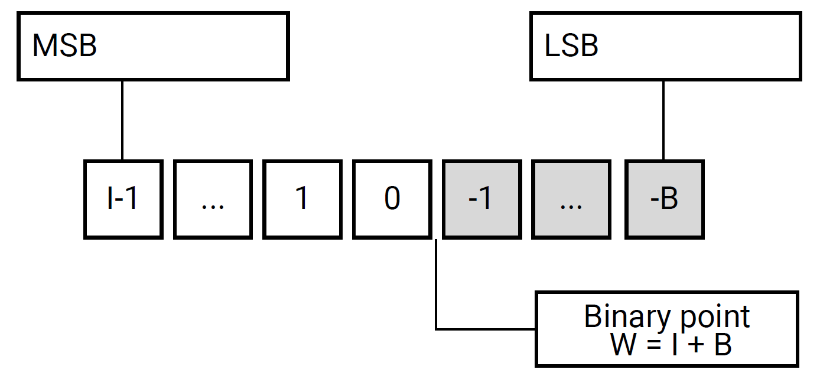
Arbitrary Data Precision using FPGA
Arbitrary precision integers:
Signed: ap_int<W>
Unsigned: ap_uint<W>
W is the user-specified bitwidth
Arbitrary precision fixed-point representation: for decimal numbers
Templatized class ap_fixed<W, I, Q, O>
W: total binary bits
I: number of integer bits (including sign bit)
Q: quantization mode
O: overflow mode
#include “ap_int.h”
…
ap_int<9> x; // 9-bit
ap_uint<17> y; // 17-bit unsigned
ap_uint<512> z; // 512-bit unsigned

Slide 9
Example: Fixed-Point Modeling
ap_ufixed<11, 8, AP_TRN, AP_WRAP> x;
b7 | b6 | b5 | … | b1 | b0 | … | b-3
11 is the total number of bits in the type
8 bits is the integer bitwidth
AP_TRN defines truncation behavior for quantization
AP_WRAP defines wrapping behavior for overflow

Slide 10
Fixed-Point Representation
Fix the decimal point → Fixed-point numbers
2³ | 2² | 2¹ | 2⁰ | 2⁻¹ | 2⁻² | unsigned
1 | 0 | 1 | 1 | 0 | 1 | 11.25
decimal point
2³ | 2² | 2¹ | 2⁰ | 2⁻¹ | 2⁻² | 2’C
1 | 0 | 1 | 1 | 0 | 1 | ?

Slide 11
Fixed-Point Representation
Fix the decimal point → Fixed-point numbers
2³ | 2² | 2¹ | 2⁰ | 2⁻¹ | 2⁻² | unsigned
1 | 0 | 1 | 1 | 0 | 1 | 11.25
decimal point
2³ | 2² | 2¹ | 2⁰ | 2⁻¹ | 2⁻² | 2’C
1 | 0 | 1 | 1 | 0 | 1 | -4.75
(-8 + 3.25)

Slide 12
Floating-Point vs Fixed-Point on FPGA
Floating-point requires:
Exponent alignment
Mantissa normalization
Extra control logic
Floating-point on FPGA:
High DSP usage
Multi-cycle latency
Harder to pipeline
Fixed-point on FPGA:
Integer arithmetic
Simple pipelines
Predictable latency
Operation | Floating-point | Fixed-point
Add | align + normalize | integer add
Mul | mantissa × mantissa; exponent + exponent | integer mul
Latency | Multi-cycle | 1–2 cycle
DSP usage | Very high | Very friendly
Pipeline | Challenging | Very friendly

Slide 13
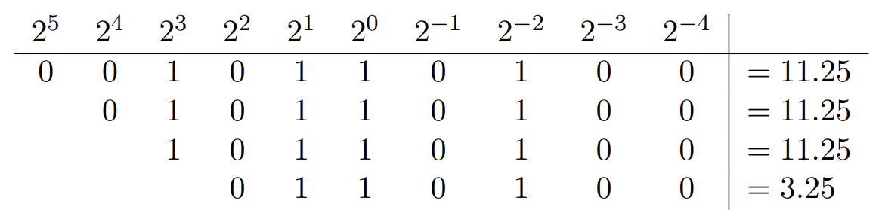
Fixed-Point Overflow and Underflow
Overflow: happens at MSB
When a number is larger than the largest that can be represented
Drop MSB
Underflow: happens at LSB
When a number is smaller than the smallest that can be represented

Slide 14
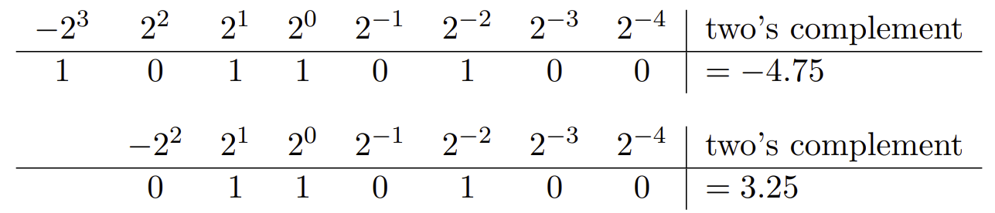
Handling Overflow
Wrapping is one common (& efficient) way of handling overflow: drop the MSBs of the original number
But… may result in a totally wrong number
Saturation: Overflow "saturates" to the maximum or minimum representable value

Slide 15
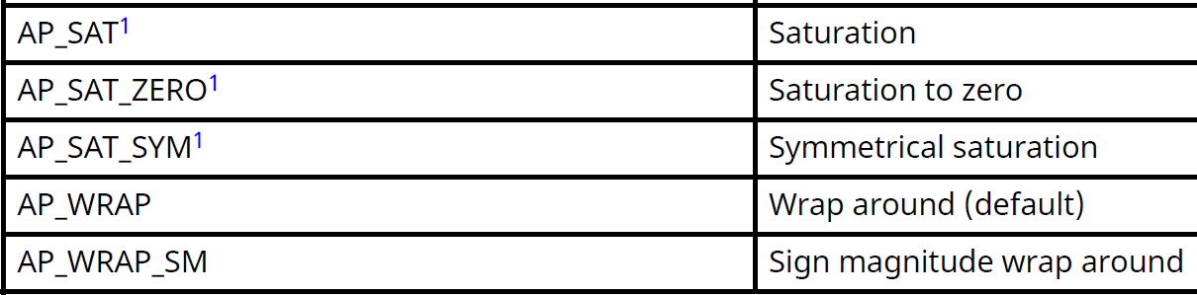
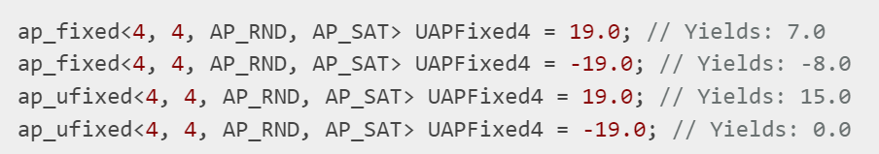
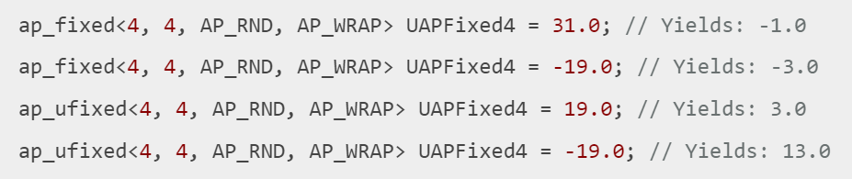
Overflow Modes in HLS
*AP_SAT Requires extra complex logic
default

Slide 16
Handling Overflow Manually
AP_SAT requires extra complex logic (uses a lot of resource)
Manually handle overflow examples:
Explicit clipping
Use larger bitwidth, e.g., larger W
Rescaling beforehand – do a comprehensive data range analysis
Ignore it if only happen rarely – in error-resilient algorithms, e.g., machine learning
float a = 176.18793;
ap_fixed<W, I> var = if (a > xxx ) ? clip_value : zzz;

Slide 17
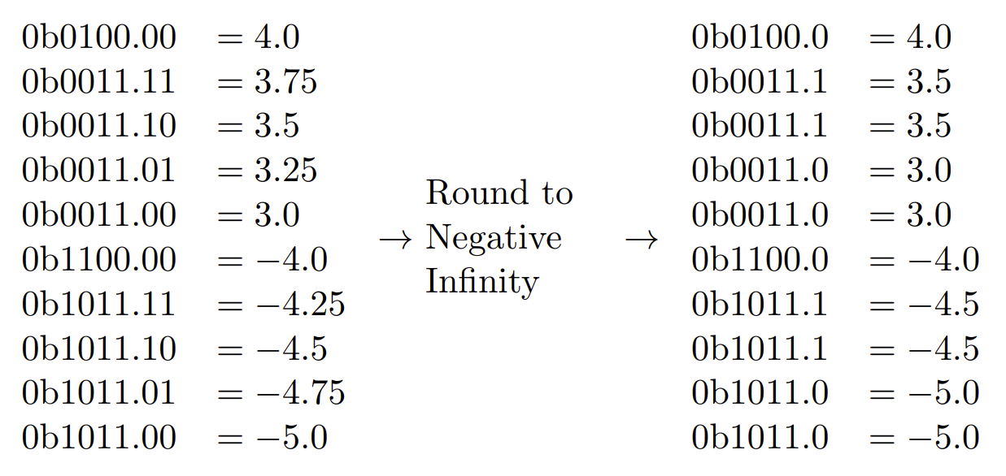
Handling Underflow – Rounding
Rounding: when a number cannot be represented precisely in a given number of fractional bits (also called quantization)
Rounding down (round to negative infinity): drop the extra fractional bits (LSBs)
Result in numbers that are more negative

Slide 18
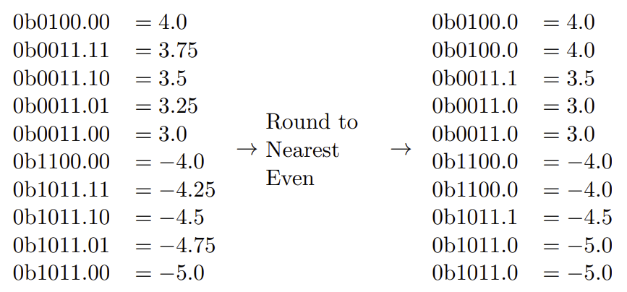
Handling Underflow – Rounding
Rounding to nearest even: always picks the nearest representable number
Minimizes rounding errors
Error tends to cancel out when computing sums – unbiased rounding
Goes larger
Goes smaller

Slide 19
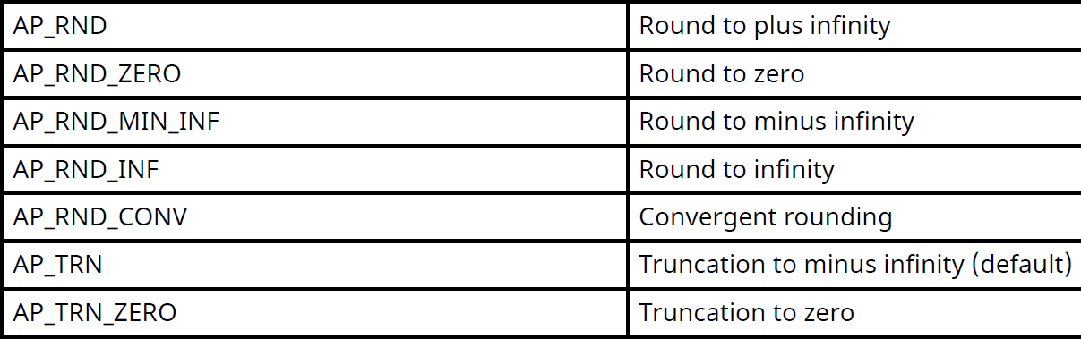


Quantization Modes in HLS
(to nearest)
default

Slide 20
Pros and Cons of Fixed Point
Pros
Low memory, low resource (DSP, peripheral logic), low latency
Cons
Uncertain accuracy
Vitis HLS can also synthesize floating point
Requires significant amount of computation → a large amount of resource usage and many cycles of latency
Floating point numbers should be avoided unless absolutely necessary

Slide 21
Pitfalls of using Fixed-Point
Representation is fine, but when comes to computation:
Intermediate results, especially accumulations, matter a lot
Usually use a larger precision for accumulation
Maybe other cases
Accumulation error grows with:
Loop trip count
Reduction (accumulation) depth
Sum overflows
Example:
8-bit × 8-bit → 16-bit product
Accumulating 256 terms → needs +8 bits
for (int i = 0; i < N; i++) {
for (int j = 0; j < N; j++) {
ap_fixed_higher_precision sum = 0;
for (int k = 0; k < N; k++) {
sum += A[i][k] * B[k][j];
}
}
C[i][j] = sum;
}

Slide 22
Outline
Floating-point and fixed-point representations
Data quantization in Machine Learning

Slide 23
Quantization for Machine Learning
Why do we care?
Faster, smaller, easier!
Why does it work?
Quantization Methods
Fixed-point
Integer
Reference: https://sahnimanas.github.io/post/quantization-in-tflite/

Slide 24
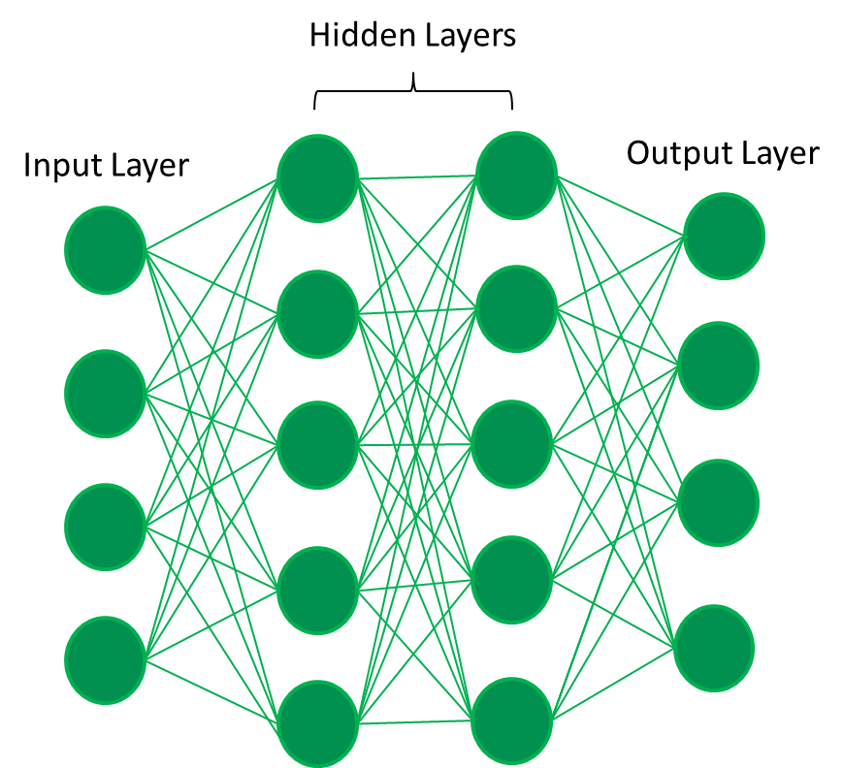


Why Does Quantization Work for ML?
DNNs are known to be robust to noise and small perturbations once trained
80% chance to be a dog? 75% chance to be a dog? Still a dog!
Cat: 0.1
Dog: 0.7
Bird: 0.1
Parrot: 0.1

Slide 25
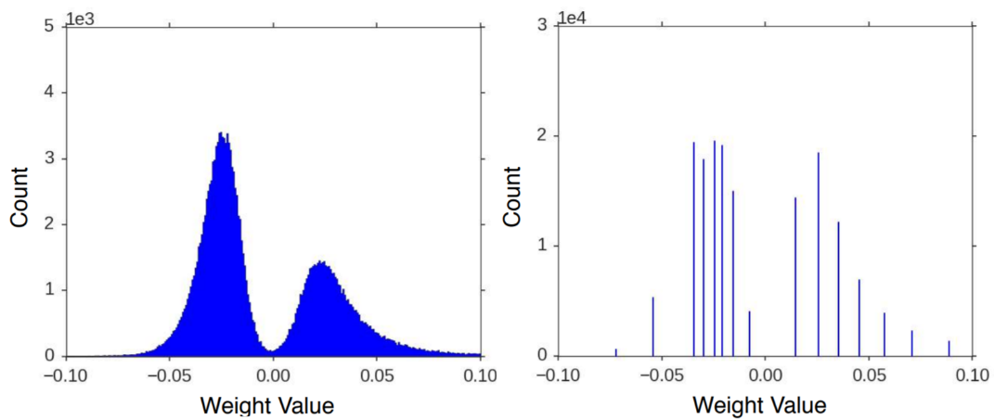
Why Does Quantization Work for ML?
DNNs are known to be robust to noise and small perturbations once trained
80% chance to be a cat? 75% chance to be a cat? Still a cat!
Weights and activations often tend to lie in a small range
Can be estimated beforehand

Slide 26
Quantization Method 1 – Fixed Point
Using fixed-point instead of floating point: most widely used in HLS
Drawback: doesn’t work well for low bit-width, e.g., < 8-bit
The range of the represented number is strictly limited by W and I
#include “ap_fixed.h”
Typedef ap_fixed<9, 3> my_fixed_type;
my_fixed_type weights[dim1][dim2];
my_fixed_type bias[dim1];
…
weights[0][0] = (my_fixed_type) weights_float[0][0];
…
sign | b2 | b1 | b0
[-4, 3.5]
step: 0.5
sign | b2 | b1 | b0
[-2, 1.75]
step: 0.25

Slide 27
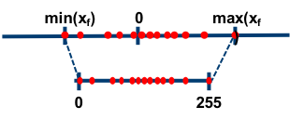


Quantization Method 2 – Integer
With a scaling and a bias (shift), can represent a much larger range
$$f=\frac{f_{max}−f_{min}}{2^{B}−1}×q+bias$$
$$f=scale×q+bias$$
8-bit
$f$ : original floating-point value
q : quantized integer
scale and bias: can be floating or fixed point
https://intellabs.github.io/distiller/algo_quantization.html

Slide 28
Quantization Method 2 – Integer (Example)
-257.8 | -117.2 | -6.3 | 0 | 18.4 | 25.3 | 66.9 | 77.3 | 128.1 | 145.6
3-bit: 2³ = 8
0 | 1 | 2 | 3 | 4 | 5 | 6 | 7

Slide 29
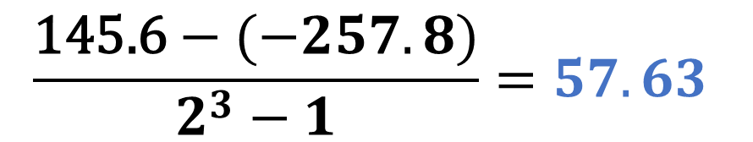
Quantization Method 2 – Integer (Example)
-257.8 | -117.2 | -6.3 | 0 | 18.4 | 25.3 | 66.9 | 77.3 | 128.1 | 145.6
$$\frac{\text{145.6}−(−257.8)}{2^{3}−1}=57.63$$
Scaling factor
3-bit: 2³ = 8
0 | 1 | 2 | 3 | 4 | 5 | 6 | 7

Slide 30

Quantization Method 2 – Integer (Example)
-257.8 | -117.2 | -6.3 | 0 | 18.4 | 25.3 | 66.9 | 77.3 | 128.1 | 145.6
$$÷57.63$$
-4.47 | -2.03 | -0.11 | 0.00 | 0.32 | 0.44 | 1.16 | 1.34 | 2.22 | 2.53
Next is to shift
3-bit: 2³ = 8
0 | 1 | 2 | 3 | 4 | 5 | 6 | 7

Slide 31
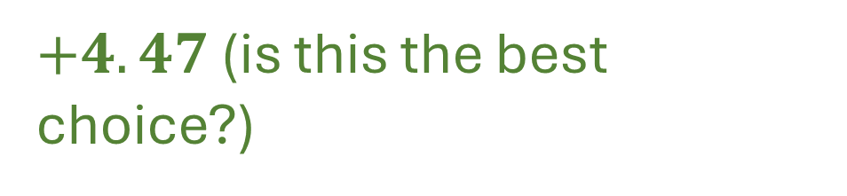
Quantization Method 2 – Integer (Example)
-257.8 | -117.2 | -6.3 | 0 | 18.4 | 25.3 | 66.9 | 77.3 | 128.1 | 145.6
$$÷57.63$$
-4.47 | -2.03 | -0.11 | 0.00 | 0.32 | 0.44 | 1.16 | 1.34 | 2.22 | 2.53
$+4.47$ (is this the best choice?)
3-bit: 2³ = 8
0 | 1 | 2 | 3 | 4 | 5 | 6 | 7

Slide 32

Quantization Method 2 – Integer (Example)
-257.8 | -117.2 | -6.3 | 0 | 18.4 | 25.3 | 66.9 | 77.3 | 128.1 | 145.6
$$÷57.63$$
-4.47 | -2.03 | -0.11 | 0.00 | 0.32 | 0.44 | 1.16 | 1.34 | 2.22 | 2.53
$$+4.47$$
0.00 | 2.44 | 4.36 | 4.47 | 4.79 | 4.91 | 5.63 | 5.81 | 6.69 | 7.00
3-bit: 2³ = 8
0 | 1 | 2 | 3 | 4 | 5 | 6 | 7

Slide 33
Quantization Method 2 – Integer (Example)
-257.8 | -117.2 | -6.3 | 0 | 18.4 | 25.3 | 66.9 | 77.3 | 128.1 | 145.6
$$÷57.63$$
-4.47 | -2.03 | -0.11 | 0.00 | 0.32 | 0.44 | 1.16 | 1.34 | 2.22 | 2.53
$$+4.47$$
0.00 | 2.44 | 4.36 | 4.47 | 4.79 | 4.91 | 5.63 | 5.81 | 6.69 | 7.00
3-bit: 2³ = 8
0 | 1 | 2 | 3 | 4 | 5 | 6 | 7

Slide 34
Quantization Method 2 – Integer (Example)
-257.8 | -117.2 | -6.3 | 0 | 18.4 | 25.3 | 66.9 | 77.3 | 128.1 | 145.6
$$÷57.63$$
-4.47 | -2.03 | -0.11 | 0.00 | 0.32 | 0.44 | 1.16 | 1.34 | 2.22 | 2.53
$$+4.47$$
0.00 | 2.44 | 4.36 | 4.47 | 4.79 | 4.91 | 5.63 | 5.81 | 6.69 | 7.00
3-bit: 2³ = 8
0 | 1 | 2 | 3 | 4 | 5 | 6 | 7
Zeros are very common in ML but are tampered

Slide 35

Quantization Method 2 – Integer (Example)
-257.8 | -117.2 | -6.3 | 0 | 18.4 | 25.3 | 66.9 | 77.3 | 128.1 | 145.6
$$÷57.63$$
-4.47 | -2.03 | -0.11 | 0.00 | 0.32 | 0.44 | 1.16 | 1.34 | 2.22 | 2.53
$$+5$$
0.53 | 2.97 | 4.89 | 5.00 | 5.32 | 5.44 | 6.16 | 6.34 | 7.22 | 7.53
3-bit: 2³ = 8
0 | 1 | 2 | 3 | 4 | 5 | 6 | 7
A better approach: align the zero!

Slide 36
Quantization Method 2 – Integer (Example)
-257.8 | -117.2 | -6.3 | 0 | 18.4 | 25.3 | 66.9 | 77.3 | 128.1 | 145.6
$$÷57.63$$
Many researches are trying to find the optimal scaling factor and bias…
-4.47 | -2.03 | -0.11 | 0.00 | 0.32 | 0.44 | 1.16 | 1.34 | 2.22 | 2.53
$$+5$$
0.53 | 2.97 | 4.89 | 5.00 | 5.32 | 5.44 | 6.16 | 6.34 | 7.22 | 7.53
3-bit: 2³ = 8
0 | 1 | 2 | 3 | 4 | 5 | 6 | 7
A better approach: align the zero!

Slide 37
Fixed-Point vs Integer Quantization
Key Difference: Coupled vs Decoupled Range
Fixed-point:
Range determined by I
Precision determined by W − I
Strongly coupled
Integer quantization:
Range controlled by scale + bias
Precision controlled by integer bit-width
Decoupled design
Integer quantization enables ultra-low-bit inference

Slide 38
When to Use What (Decision Guide)
Choosing the Right Numeric Representation
Floating-point:
High dynamic range
Control-heavy logic
Fixed-point:
Medium precision
Known ranges
Integer quantization:
ML inference
≤8-bit
High efficiency
Precision choice = performance choice

Slide 39
Summary
Floating point representation
Fixed point representation
Overflow, underflow, rounding
Data quantization in Machine Learning
Two approaches

